Slide 1
Request for Initial
Assistive Technology Consultation

Slide 2
AIU Mission & Vision
Our Mission
We are an educational community that advocates and advances equitable opportunities for every learner.
Our Vision
Through equitable access, all learners
achieve their full potential.

Slide 3
Presenter Accessibility Promise
In a commitment to make this presentation as accessible as possible, some of the strategies used today include:
  Simple backgrounds with high-contrast, real text
  Digital materials provided
  Shortened links, QR codes, and hyperlinks
  Alt text for images and videos
  Spoken description of the slides and slide contents
  Multiple visual examples
  Captions
  Multiple opportunities and options for participation
  National Center on Accessible Educational Materials

Slide 4
Changes to the Assistive Technology Service
Effort to truly build local capacity
  Initial, standard service is a synchronous team discussion (face-to-face or virtual)
  Discussion is facilitated by the TaC Coordinator
  Action plans/notes are generated by the team members
  Additional support is available as needed (and defined in action steps)
    guidance on the implementation of existing supports and resources
    trial of AT devices or software
    AT training and implementation support for team members
    observations by the AIU TaC Coordinator to gather additional information for revised action planning

Slide 5
Changes to the Assistive Technology Process
Streamlined request process
  Online request made by liaison/meeting coordinator
  Documentation is uploaded during the form completion (requires Google login)
  Meeting participants and potential dates/times are provided by the LEA

Slide 6
Initial Meeting
Anticipate 1 hour for the discussion.
Meeting participants need to have DIRECT knowledge about:
  the student.
  the instruction, activities, materials, and tasks the student engages in each day.
  the environment and personnel supports available to the student.

Slide 7
Initial Meeting – Required Attendees
All meeting participants are REQUIRED to attend the initial meeting for its full duration.
An effort is made to keep the number of required participants to a minimum for LEA staffing/coverage purposes.
Input from other (non-attending) team members can and should be provided via the meeting coordinator before and after the AT planning meeting.

Slide 8
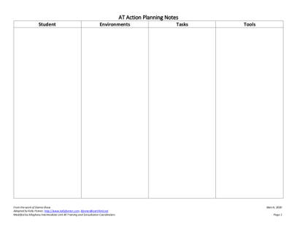
AT Action Planning Notes
Provided electronically as a Google Doc
Serves as the record of the discussion and recommendations
Features columns for each component of the SETT Framework
  Student
  Environments
  Tasks
  Tools

Slide 9
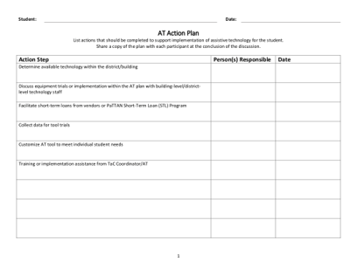
Optional AT Action Plan
Optional AT Action Plan template to allow teams to capture the specific action steps, person(s) responsible, and date
Sample steps include:
  Determine available technology/equipment with the district/building
  Discuss equipment trials or implementation within the AT plan with building-level/district-level technology staff
  Facilitate short-term loans from vendors or PaTTAN Short-Term Loan (STL) Program
  Collect data for tool trials
  Customize AT tool to meet individual student needs
  Training or implementation assistance from TaC Coordinator/AT

Slide 10
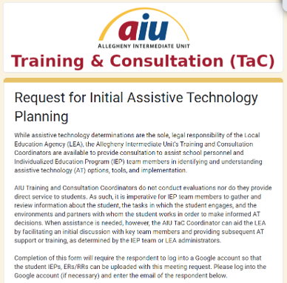
Links to Google Form
Requests are processed via a Google Form entitled “Request for Initial Assistive Technology Planning”

Slide 11
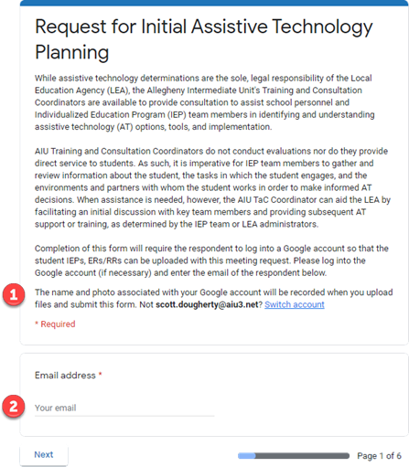
Section 1
Verify the Google Account that is currently logged in for Google Form’s use
Enter the email of the person completing the submission

Slide 12
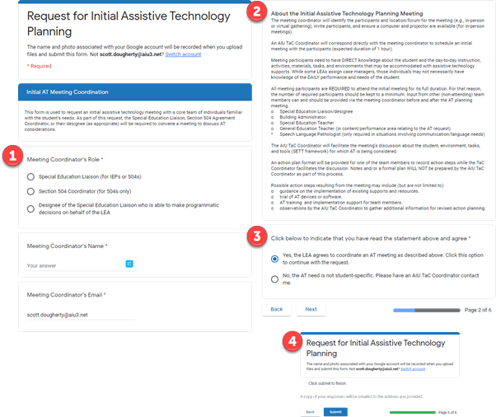
Section 2
Provides contact information for scheduling the initial meeting
Details the meeting parameters
Click Yes to continue the request
Click No to exit the form and submit contact information for follow-up

Slide 13
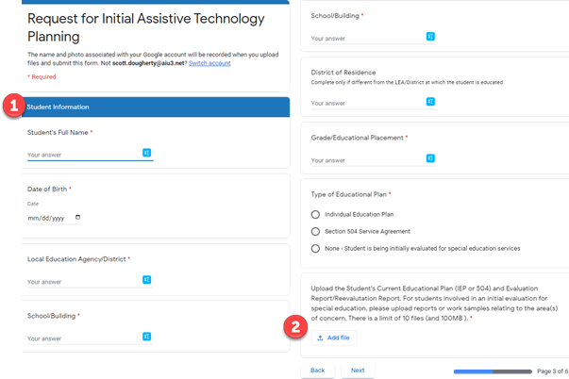
Section 3
Enter student information
Upload the ER/RR and IEP/504 (limit of 10 files and 100 MB)

Slide 14
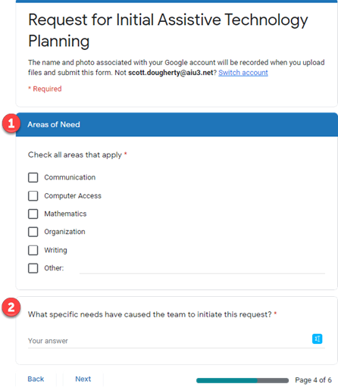
Section 4
Indicate the type(s) of AT supports to explore
Add additional, relevant information regarding the AT needs

Slide 15
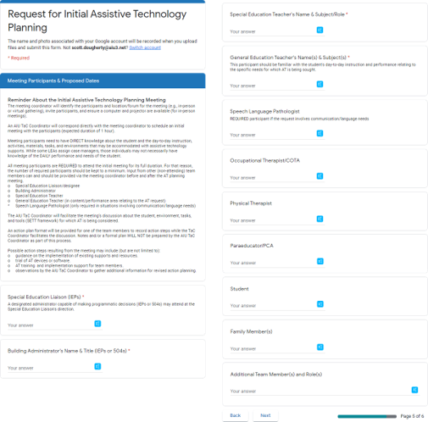
Section 5
Collects participants’ names
  Special Education Liaison/designee
  Building Administrator
  Special Education Teacher
  General Education Teacher (in content/performance area relating to the AT request)
  Speech Language Pathologist (for communication/ language needs)

Slide 16
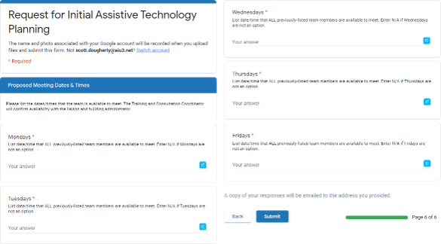
Section 6
Propose when previously named participants can meet each day of the week
  Time range on a specific day of the week
    “Any Tuesday between 12:45 and 3:20”
  Specific date and time
    “7:30 AM to 8:30 AM on 07/29/2020 or 08/12/2020”
  “Unavailable”

Slide 17
Scheduling
Jamila Robinson-Moore will confirm materials are received and notify TaC Coordinator
TaC Coordinator will contact the LEA to schedule a meeting
LEA will ensure technology/room and participants are arranged for district staff

Slide 18
Non-Discrimination Statement
The Allegheny Intermediate Unit is an equal opportunity education institution and will not discriminate on the basis of race, color, age, creed, religion, sex, sexual orientation, gender identity or expression, ancestry, place of birth, national origin, marital status, familial status, genetic information, pregnancy, handicap/disability, status as a handler or trainer of support or guide animals, or any other legally protected characteristic in its educational programs, services, facilities, activities or employment practices as required by Title IX of the 1972 Educational Amendments, Title VI and VII of the Civil Rights Act of 1964, as amended, Section 504 Regulations of the Rehabilitation Act of 1973, the Age Discrimination in Employment Act of 1975, Section 204 Regulations of the 1984 Carl D. Perkins Act, the Americans with Disabilities Act, the Pennsylvania Human Relations Act, or any other applicable federal, state, or local law. Any person who believes that s/he has been subjected to discrimination shall report all incidents of such conduct to Erin Koebel, Director of Human Resources and Labor Relations, Title IX Coordinator, Allegheny Intermediate Unit, 475 East Waterfront Drive, Homestead, PA 15120. 412-394-5957 erin.koebel@aiu3.net.
For more information about the AIU visit us online – aiu3.net

